Slide 1
Chapter 6
Repetition
Objectives
❏ To understand basic loop concepts:
■ pretest loops and post-test loops
■ loop initialization and updating
■ event and counter controlled loops
❏ To understand and be able to select the best loop construct for a given problem.
❏ To write programs that use the while, for, or do ... while statements.
❏ To understand the basic concepts and usage of recursion algorithms.
❏ To understand and be able to determine the efficiency of an algorithm through
an analysis of its looping constructs.

Slide 2
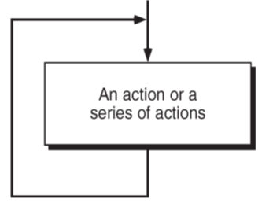
6-1 Concept of a loop
The real power of computers is in their ability to repeat an operation or a series of operations many times. This repetition, called looping, is one of the
basic structured programming concepts.
Each loop must have an expression that determines if the loop is done. If it is not done, the loop repeats one more time; if it is done, the loop terminates.
FIGURE 6-1 Concept of a Loop

Slide 3
6-2 Pretest and Post-test Loops
We need to test for the end of a loop, but where should we check it—before or after each iteration? We can have either a pre- or a post-test terminating condition.
In a pretest loop, the condition is checked at the beginning of each iteration.
In a post-test loop, the condition is checked at the end of each iteration.

Slide 4
FIGURE 6-2 Pretest and Post-test Loops

Slide 5
FIGURE 6-4 Minimum Number of Iterations in Two Loops

Slide 6
6-3 Initialization and Updating
In addition to the loop control expression, two other processes, initialization and updating, are associated with almost all loops.
Topics discussed in this section:
Loop Initialization
Loop Update

Slide 7
FIGURE 6-5 Loop Initialization and Updating

Slide 8
6-4 Event- and Counter-Controlled
Loops
6-4 Event- and Counter-Control
All the possible expressions that can be used in a loop limit test can be summarized into two general categories: event-controlled loops and counter-controlled loops.
Topics discussed in this section:
Event-Controlled Loops
Counter-Controlled Loops
Loop Comparison

Slide 9
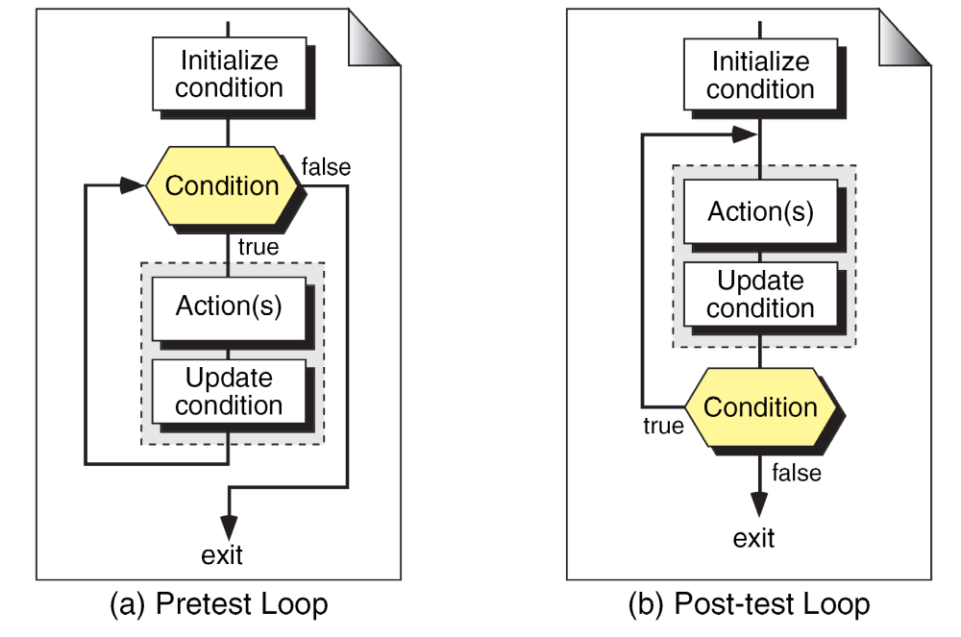
FIGURE 6-7 Event-controlled Loop Concept

Slide 10
FIGURE 6-8 Counter-controlled Loop Concept

Slide 11
6-5 Loops in C
C has three loop statements: the while, the for, and the do…while. The first two are pretest loops, and the
the third is a post-test loop. We can use all of them
for event-controlled and counter-controlled loops.
Topics discussed in this section:
The while Loop
The for Loop
The do…while Loop
The Comma Expression

Slide 12
FIGURE 6-9 C Loop Constructs

Slide 13
FIGURE 6-10 The while Statement

Slide 14
FIGURE 6-11 Compound while Statement

Slide 15
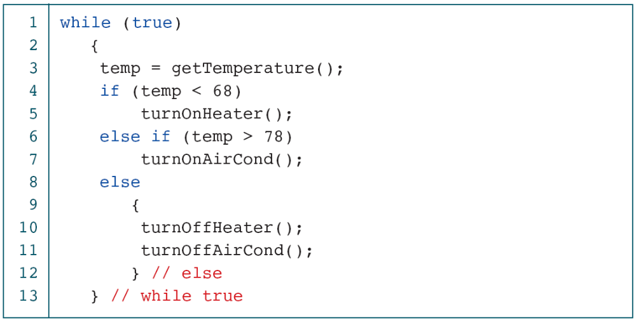
PROGRAM 6-1
Process-control System Example

Slide 16
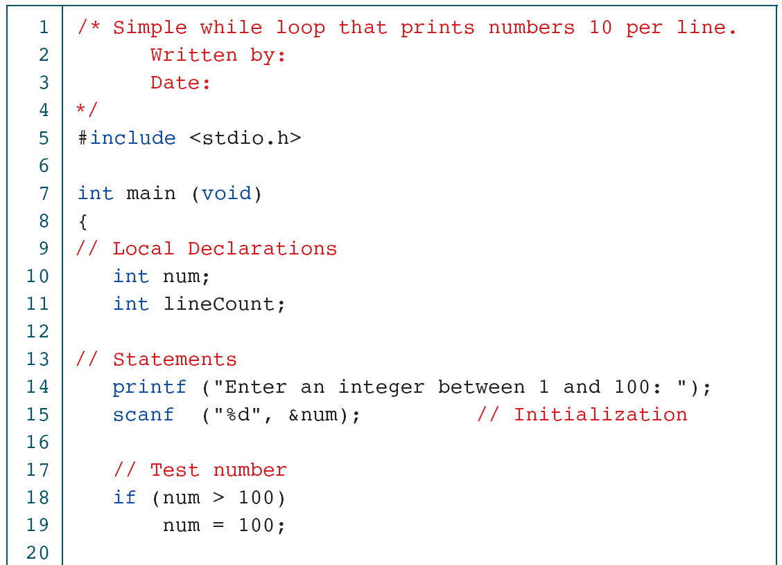
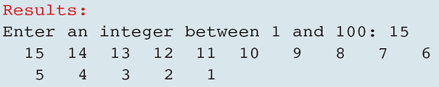
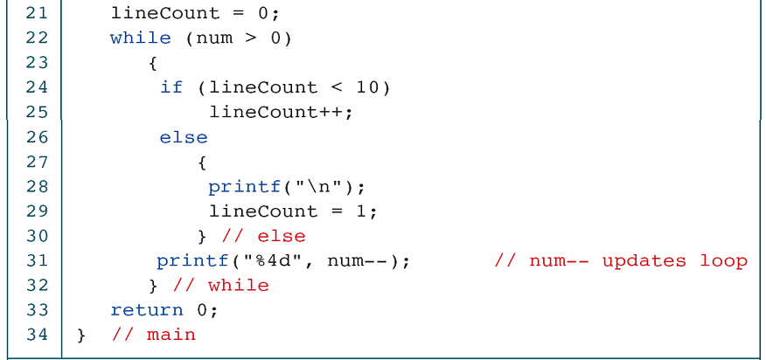
PROGRAM 6-2
A while Loop to Print Numbers

Slide 17
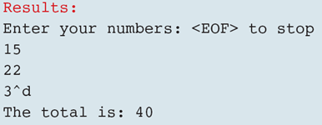
PROGRAM 6-3
Adding a List of Numbers

Slide 18
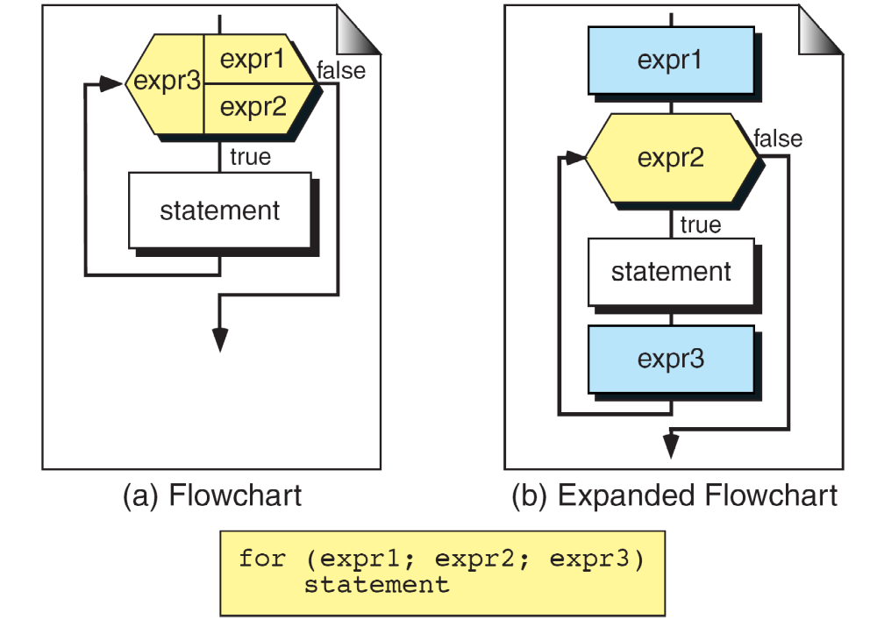
FIGURE 6-12 for Statement

Slide 19
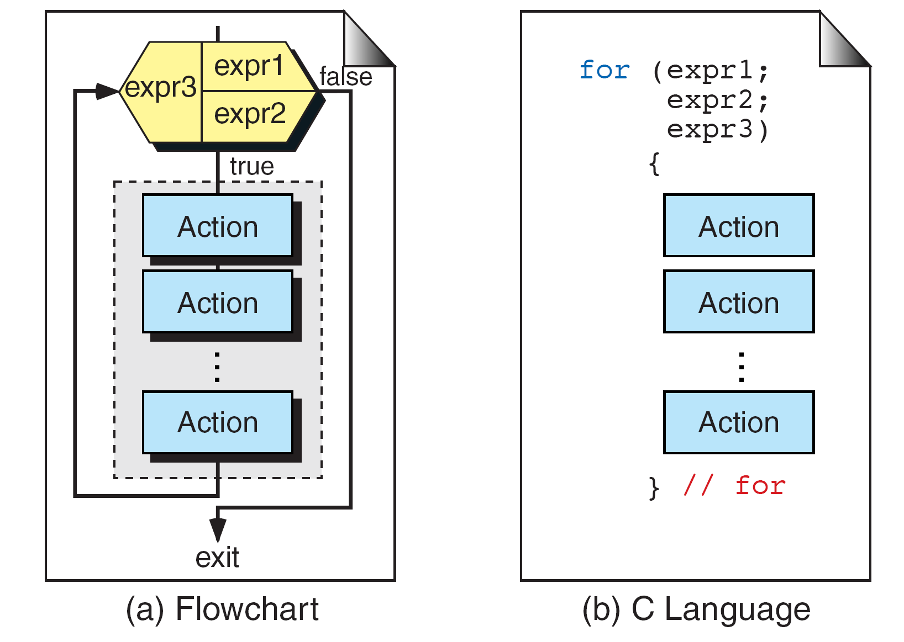
FIGURE 6-13 Compound for Statement

Slide 20
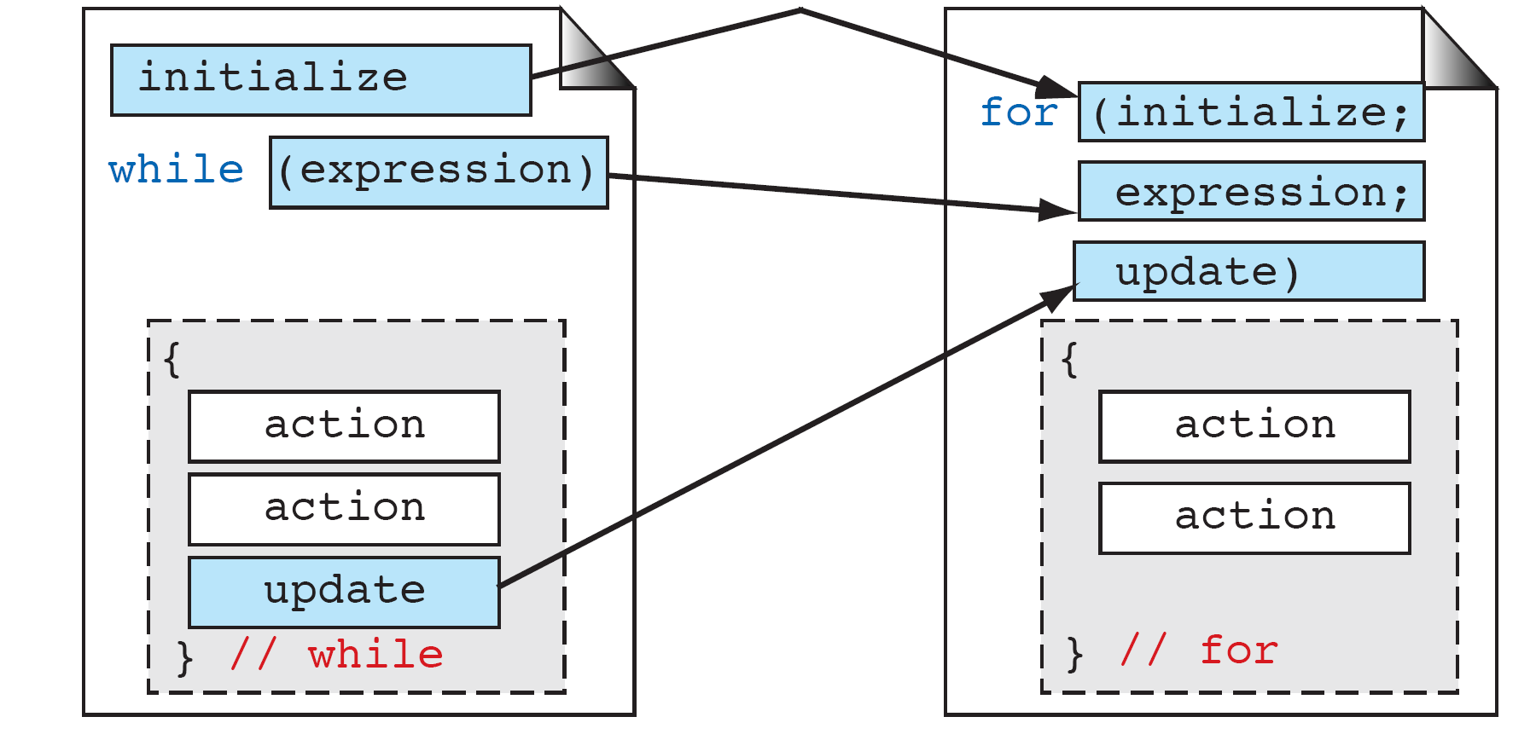
FIGURE 6-14 Comparing for and while Loops

Slide 21
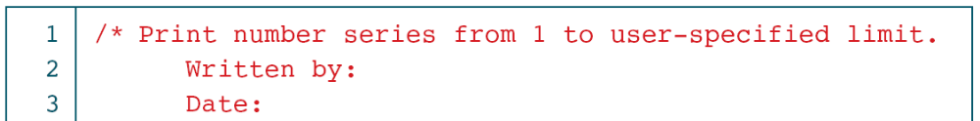
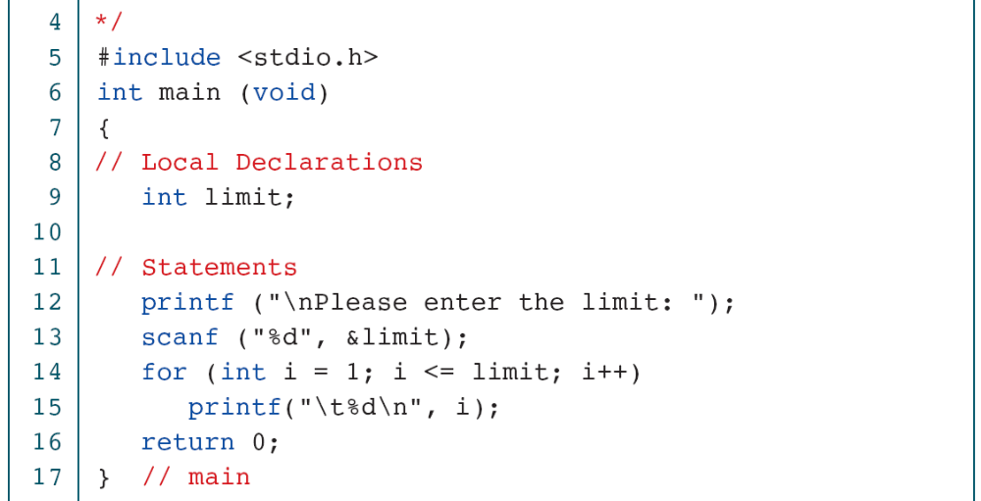
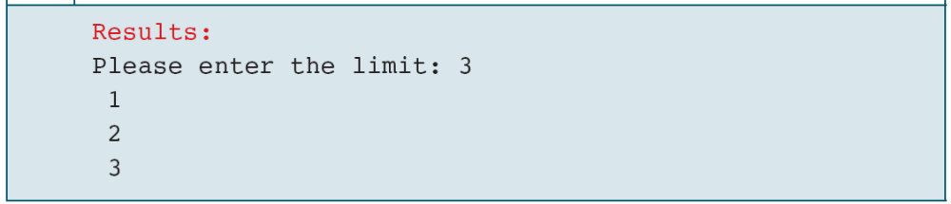
PROGRAM 6-4
Example of a for Loop

Slide 22
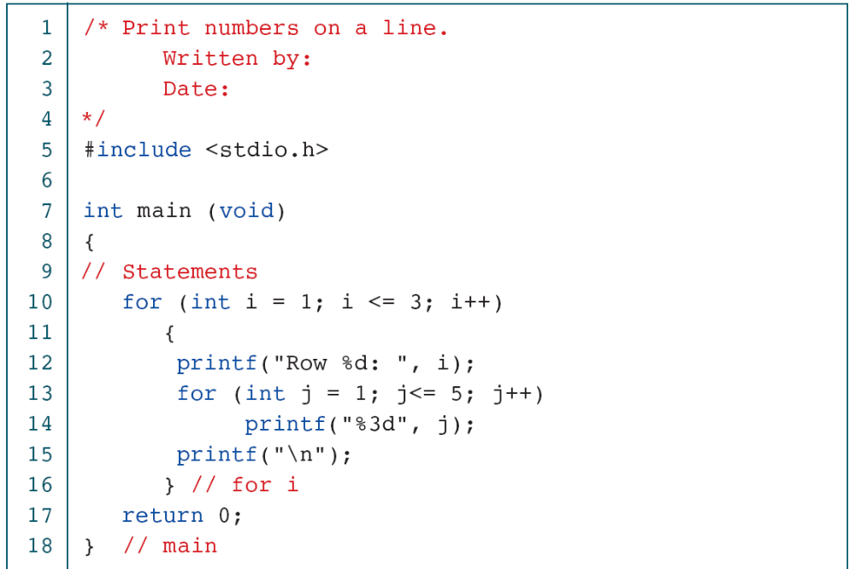
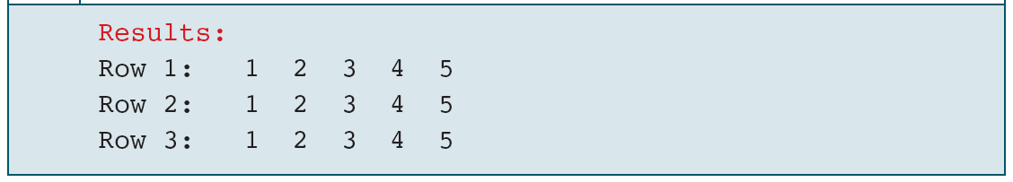
PROGRAM 6-5
A Simple Nested for Loop

Slide 23
FIGURE 6-15 do…while Statement

Slide 24
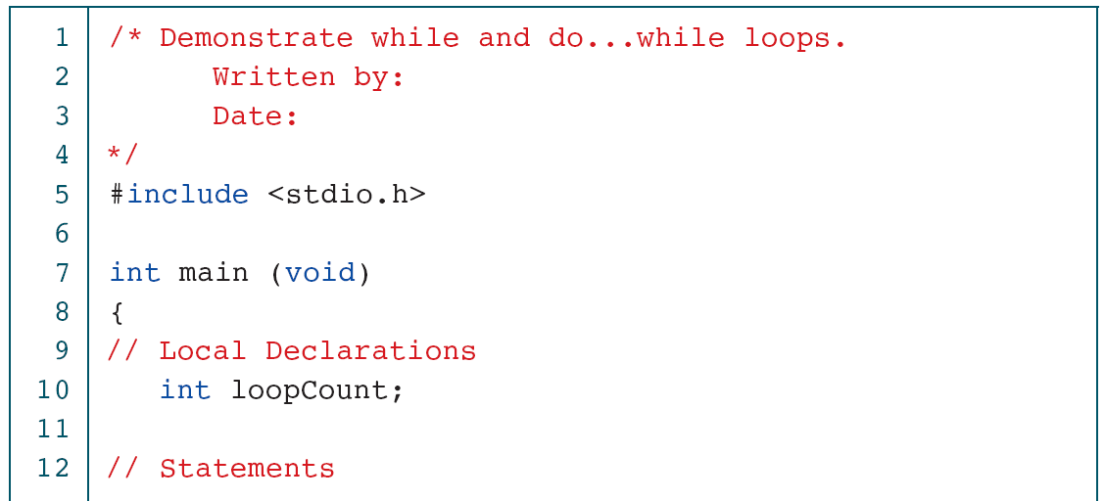
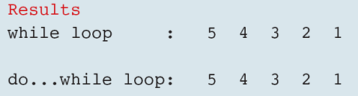
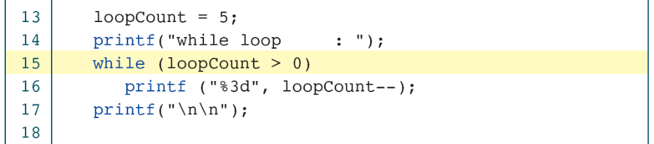
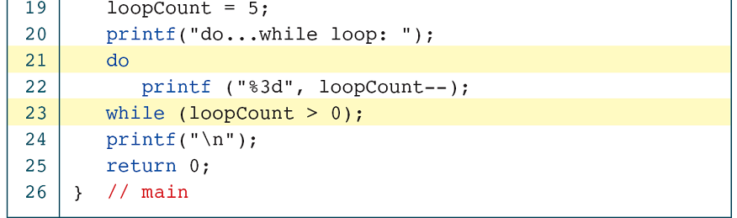
PROGRAM 6-6
Two Simple Loops

Slide 25
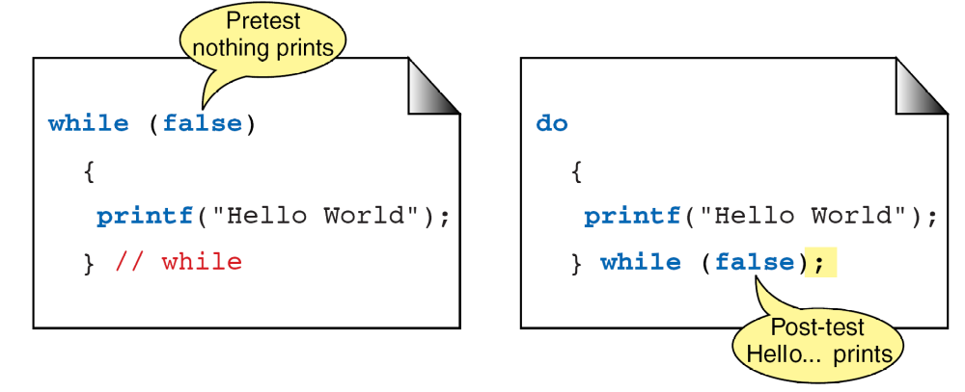
FIGURE 6-16 Pre- and Post-test Loops

Slide 26
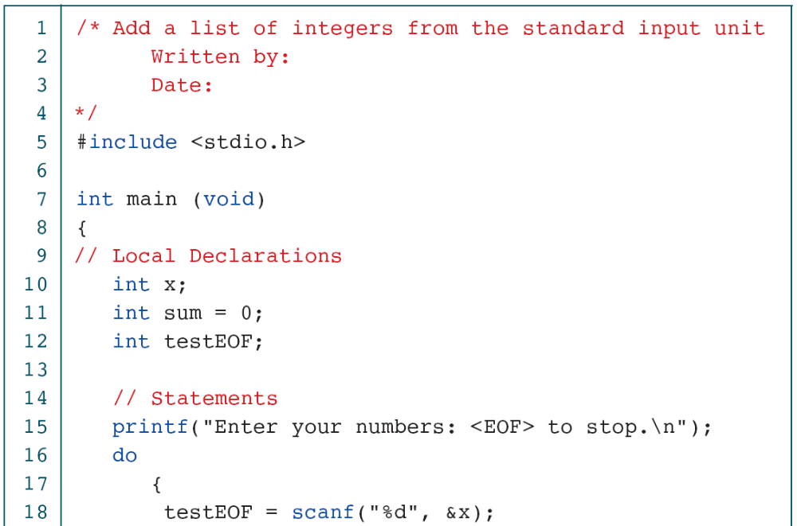
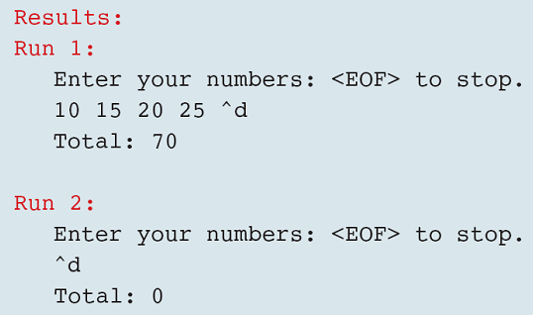
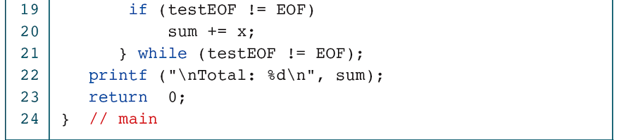
PROGRAM 6-7
Adding a List with the do…while

Slide 27
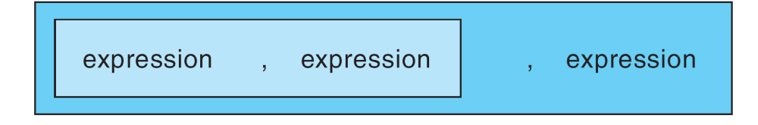
FIGURE 6-17 Nested Comma Expression

Slide 28
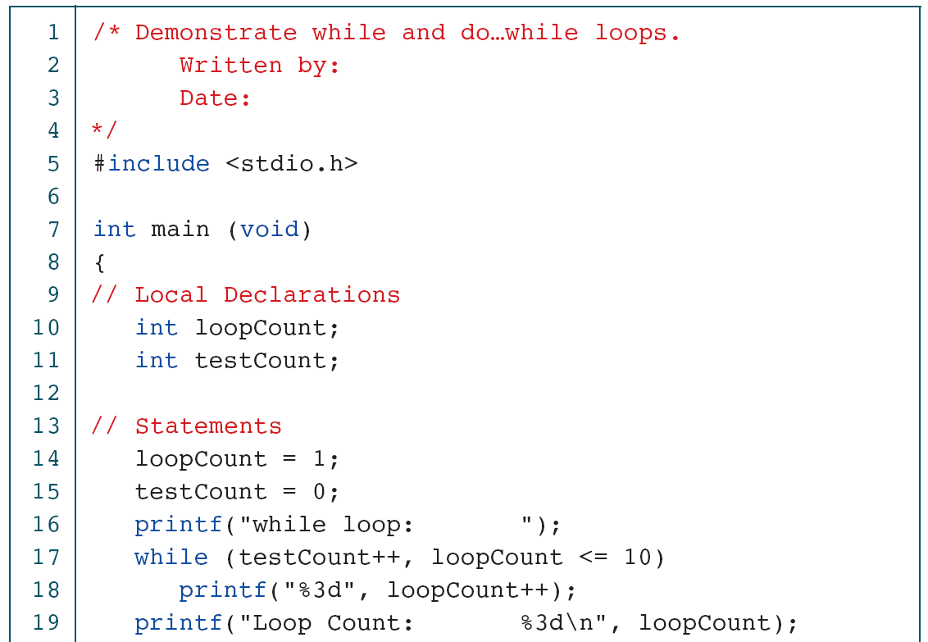
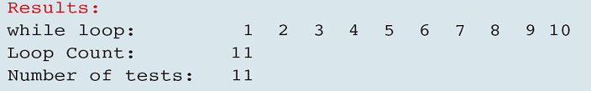
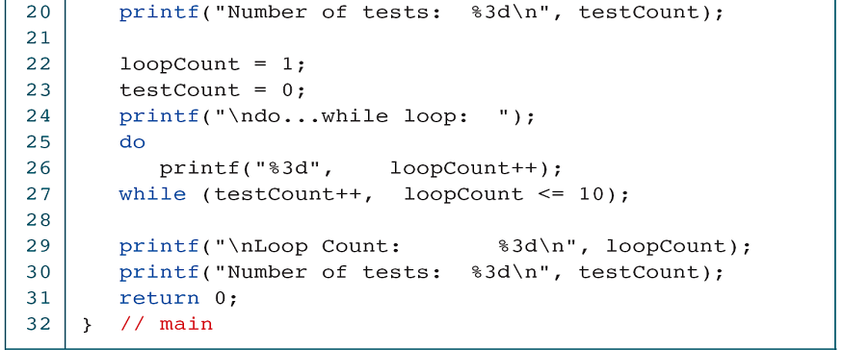

PROGRAM 6-8
Comparison of while and do…while

Slide 29
6-6 Loop Examples
This section contains several short examples of loop applications. Each program demonstrates one or more programming concepts that you will find helpful in solving other problems.
Topics discussed in this section:
for Loops
while LOOPS
do…while LOOPS

Slide 30
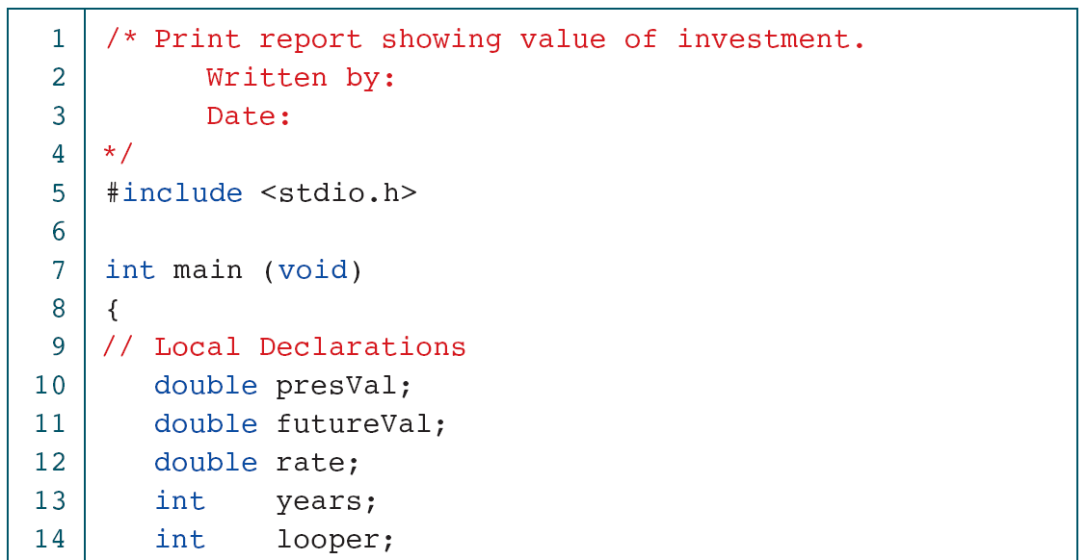
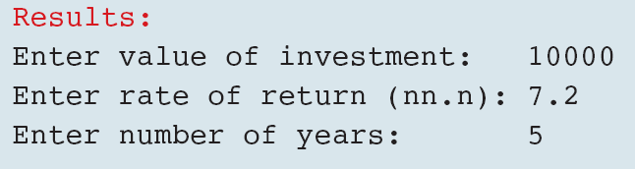
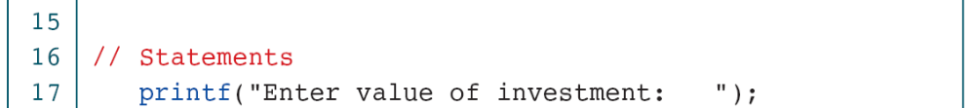
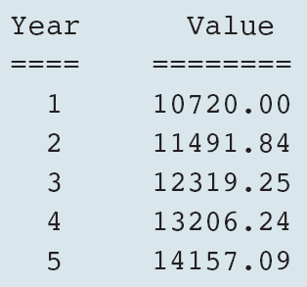
PROGRAM 6-9
Compound Interest

Slide 31
FIGURE 6-18 Print Right Triangle Flowchart and Pseudocode

Slide 32
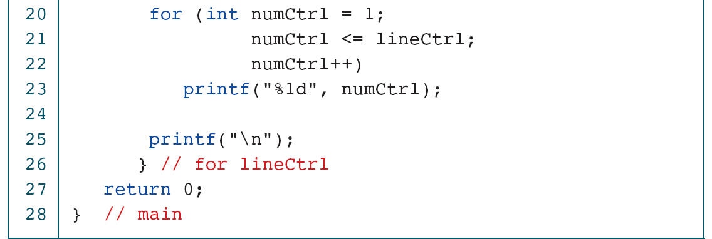
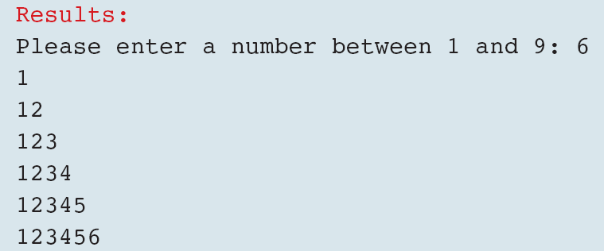
PROGRAM 6-10
Print Right Triangle Using Nested for

Slide 33
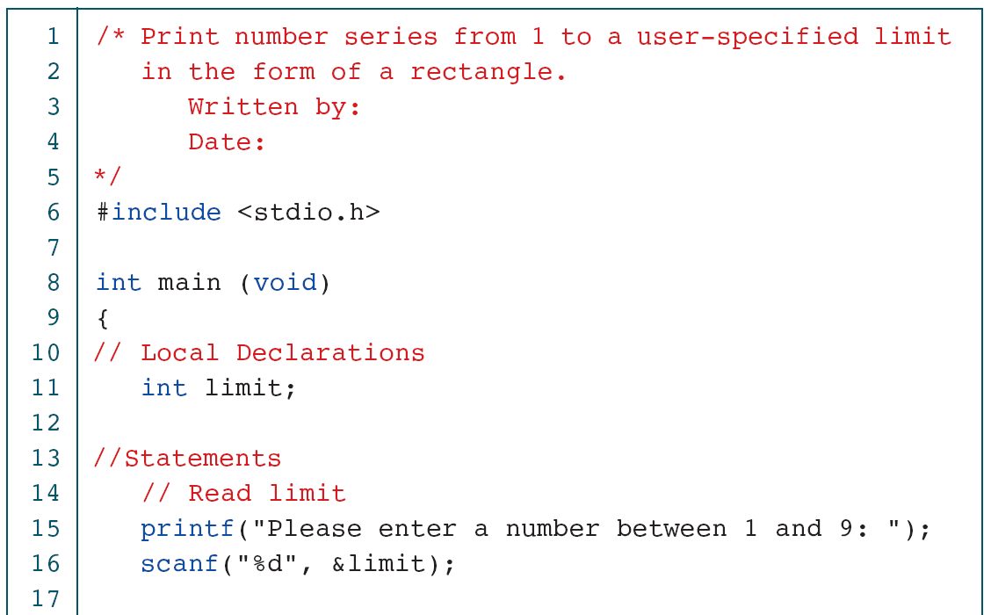
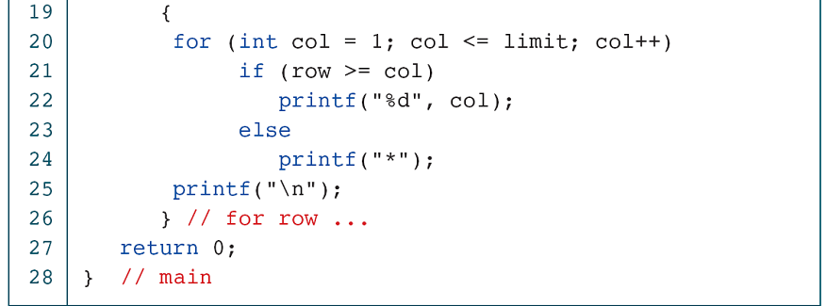
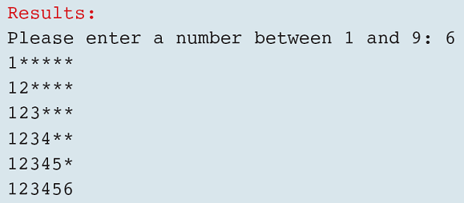
PROGRAM 6-11
Print Number Series Using User-specified Limit
for (int row=1; row<=limit; row++)

Slide 34
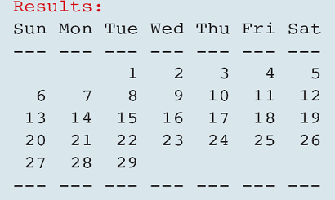
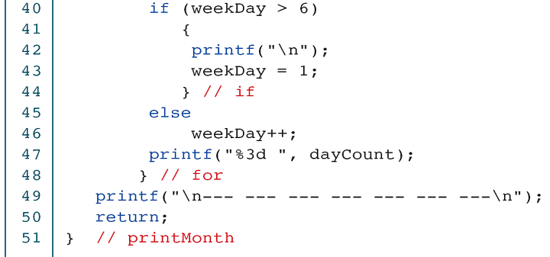
PROGRAM 6-12
Print Calendar Month

Slide 35
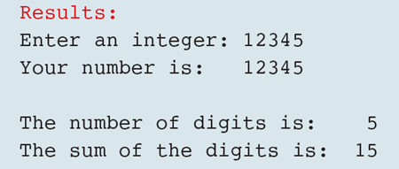
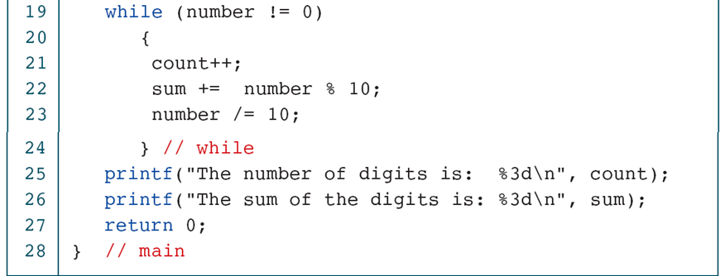
PROGRAM 6-13
Print Sum of Digits

Slide 36
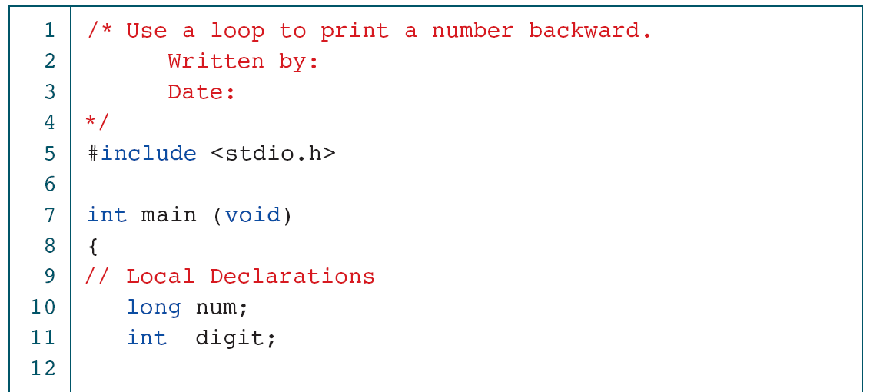
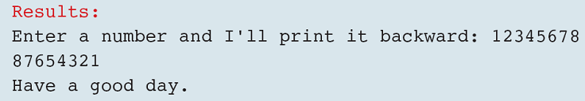
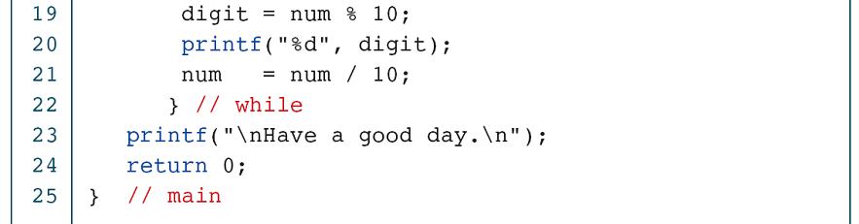
PROGRAM 6-14
Print Number Backward

Slide 37
6-7 Other Statements Related
to Looping
Three other C statements are related to loops: break, continue, and goto. The last statements, the goto, is not valid for structured programs and therefore is not discussed in this text.
Topics discussed in this section:
break
continue

Slide 38
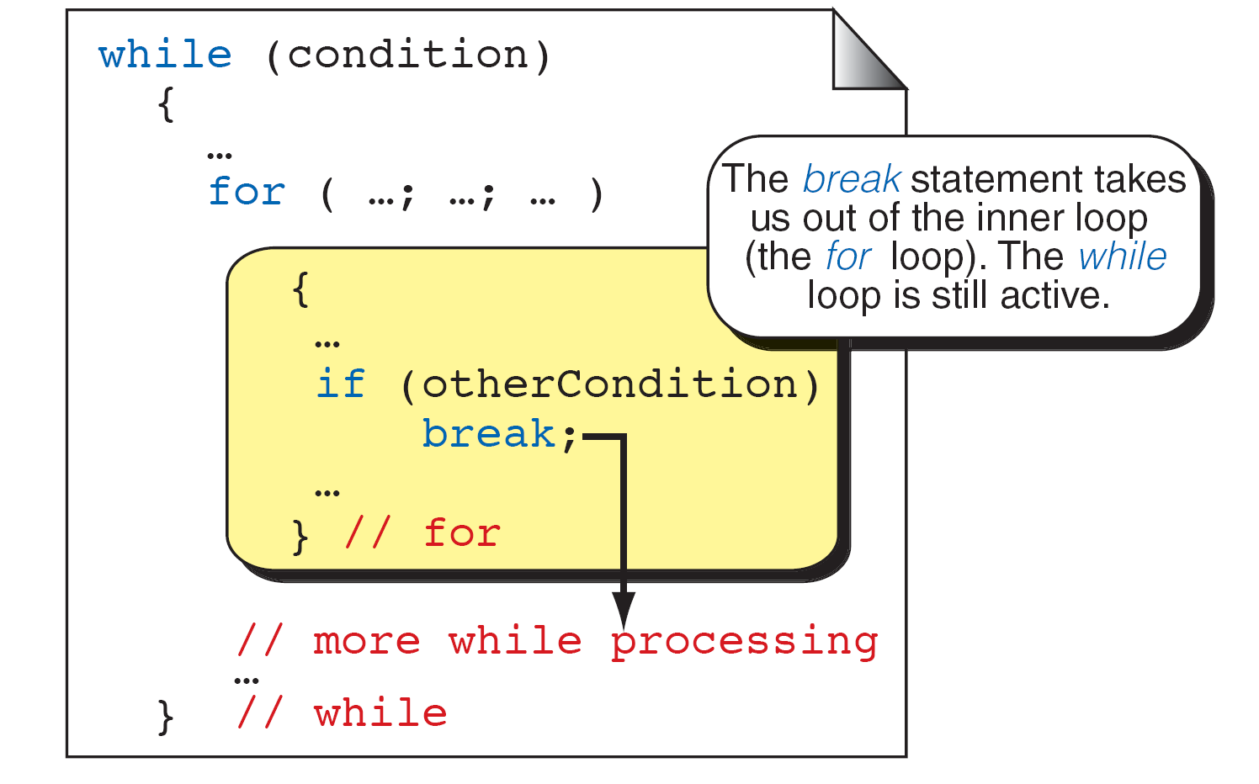
FIGURE 6-20 break and Inner Loops

Slide 39
PROGRAM 6-16
The for and while as Perpetual Loops

Slide 40
PROGRAM 6-17
Using a break Flag

Slide 41
FIGURE 6-21 The continue Statement

Slide 42
PROGRAM 6-18
continue Example

Slide 43
6-8 Looping Applications
In this section, we examine four common applications for loops: summation, product, smallest and largest, and inquiries. Although the uses for loops are virtually endless, these problems illustrate many common applications.
Topics discussed in this section:
Summation
Powers
Smallest and Largest
Inquiries

Slide 44
FIGURE 6-22 Summation and Product Loops

Slide 45
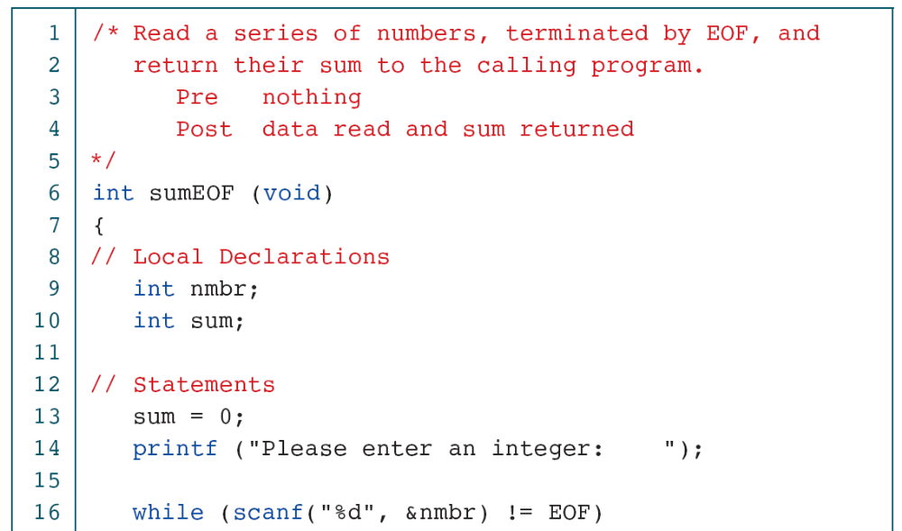
PROGRAM 6-19
Sum to EOF Function

Slide 46
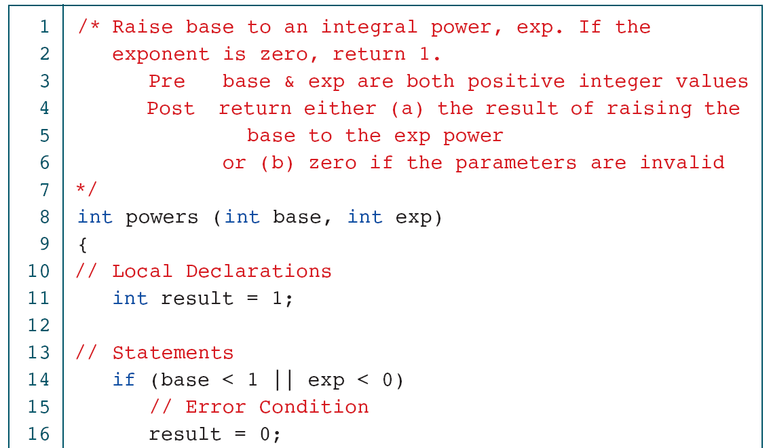
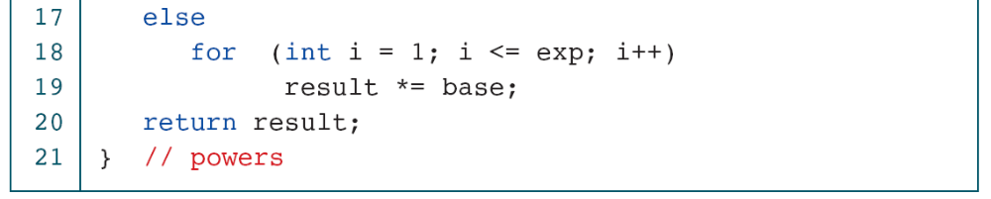
PROGRAM 6-20
Powers Function

Slide 47
FIGURE 6-23 Smallest and Largest Loops

Slide 48
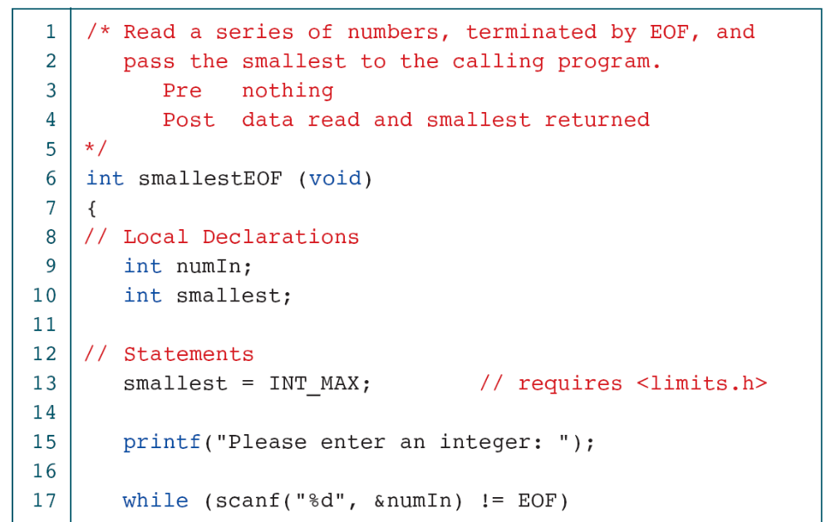
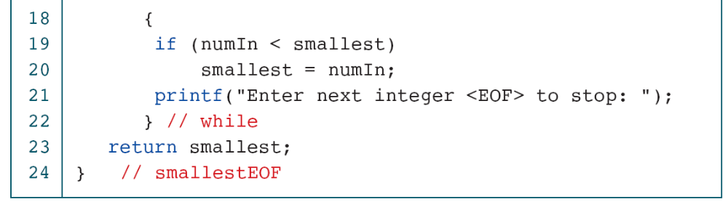
PROGRAM 6-21
Smallest to EOF Function

Slide 49
Note
To find the largest, we need to initialize the smallest variable to a very small number, such as INT_MIN.
To find the smallest, we need to initialize the result to a very large number, such as INT_MAX.

Slide 50
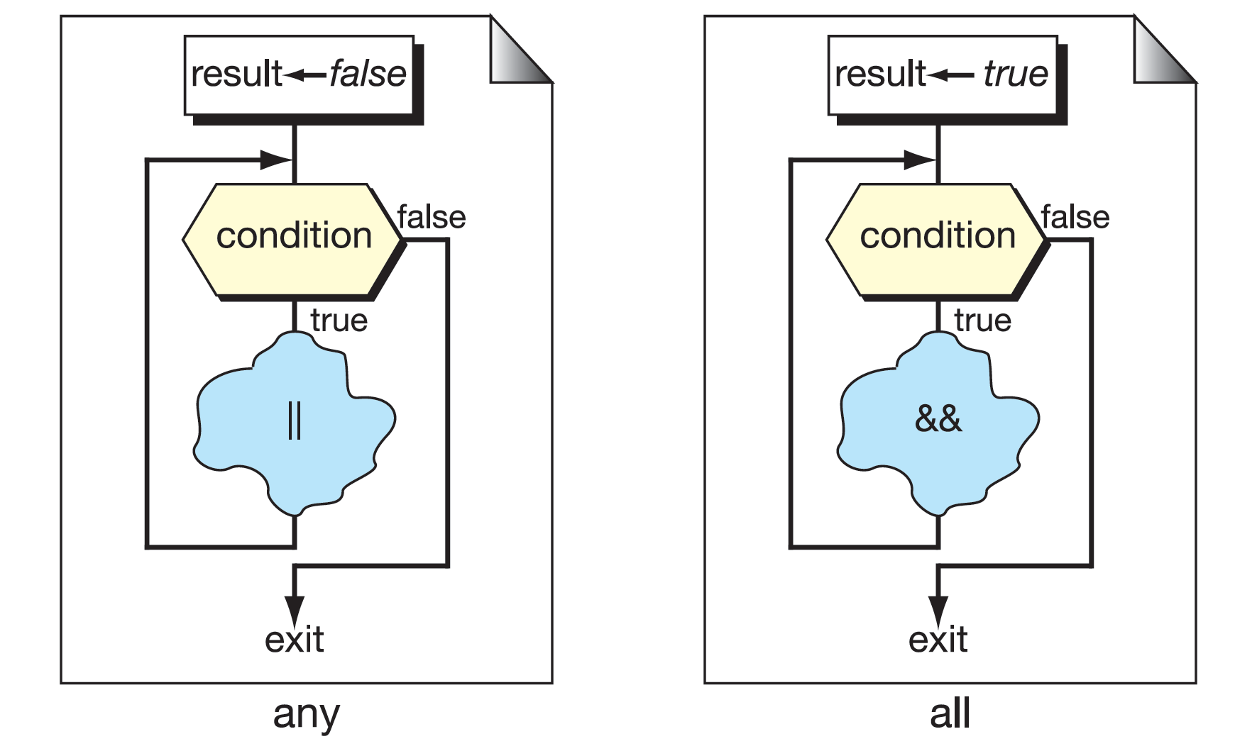
FIGURE 6-24 any and all Inquiries

Slide 51


PROGRAM 6-22
anyPositive to EOF Function

Slide 52


PROGRAM 6-23
All Positive Function

